Slide 1
CSC402:PROGRAMMING I
CHAPTER 1: INTRODUCTION

Slide 2
DO YOU REMEMBER?
What is a computer?
What is the basic operations of a computer?
First computer language?
Second programming language?
Third level of programming language?

Slide 3
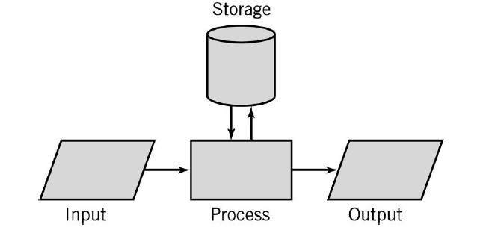
BASIC OPERATION OF A COMPUTER

Slide 4
PROGRAM AND PROGRAMMING
Program
Programming
Program is made up of sequence of instructions and decisions that the computer carries out to achieve a specific task.
A process of problem solving.

Slide 5
PROGRAMMING LANGUAGE
Programming language
Computer language
Low level: Assembly Language
High level: C, C++
Language used to write computer program, it allows human to communicate instructions to machines.
Programming paradigm
Object-oriented
Functional
Logic

Slide 6
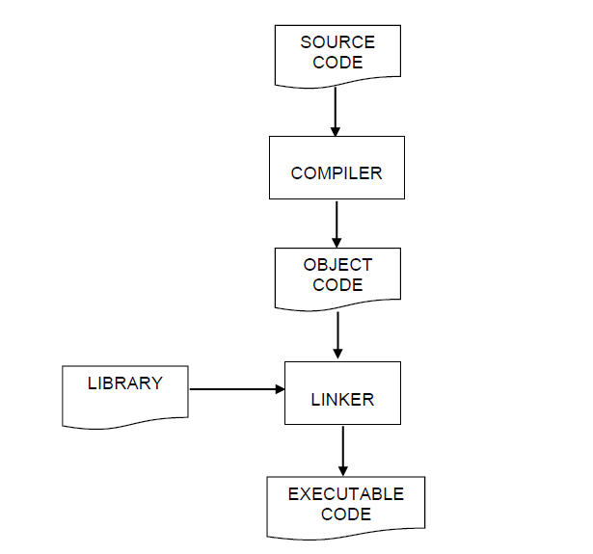
COMPILATION PROCESS
Process:
Source Code – high level language
Compiler – interpreted into machine language
Linker – link the program with library
Executable code – produce by the compiler to be run

Slide 7
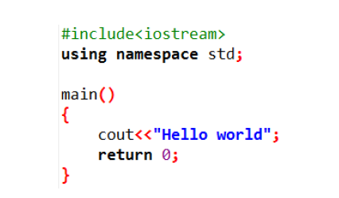

EXAMPLE OF C++ PROGRAM
Source Code
Output

Slide 8
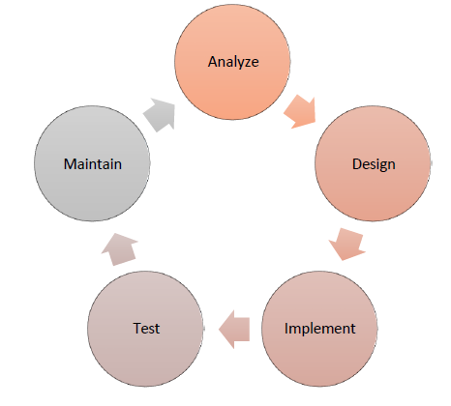
PROGRAM DEVELOPMENT LIFE CYCLE

Slide 9
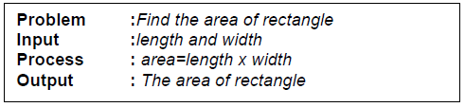
1. ANALYZE THE PROBLEM
Find the area of a rectangle. Receive length and width as the input.

Slide 10
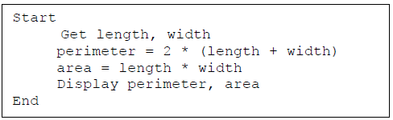
2. DESIGN THE SOLUTION
Pseudocode

Slide 11
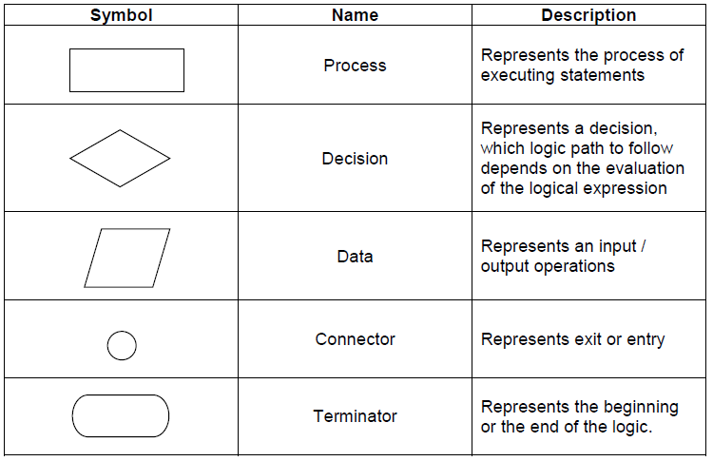
2. DESIGN THE SOLUTION
Flowchart

Slide 12
DRAW FLOWCHART FOR THE PROBLEM
ACTIVITY 1

Slide 13
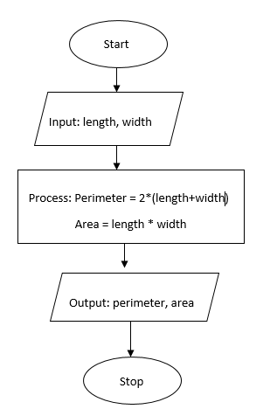
ANSWER

Slide 14
3. IMPLEMENT THE PROGRAM
Code using C++ programming language
4. TEST THE PROGRAM
Finding and eliminating errors
5. MAINTAIN THE PROGRAM
Modifying or upgrading the existing system

Slide 15
ACTIVITY 2
Solve the problems below using flowchart and pseudo codes:
1. Calculate the amount a person has to spend on petrol if the price of the petrol is RM2.10 per liter. The amount of petrol used is received as input.
2. Receives the age of a person in years and display the age in days. Assumed that a year has 365 days.
3. Write pseudo code that performs the following: Ask a user to enter a number. If the number is between 1 and 10, write the word blue. If the number is between 11 and 20, write the word red. if the number is between 21 and 30, write the word green. If it is any other number, write that it is not a correct color option.
4. Write pseudo code that will perform the following.
a) Read in 5 separate numbers.
b) Calculate the average of the five numbers.
c) Find the smallest (minimum) and largest (maximum) of the five entered numbers.
d) Write out the results found from steps b and c with a message describing what they are.

Slide 16
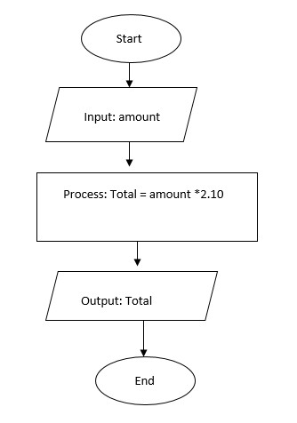
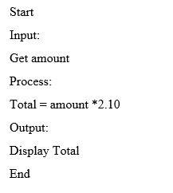
ANSWER Q1

Slide 17
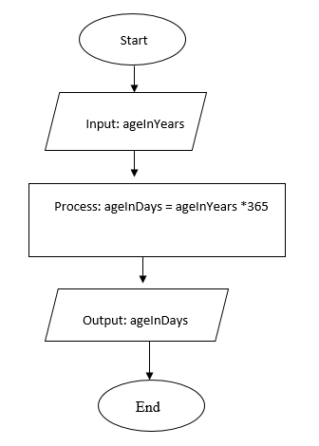
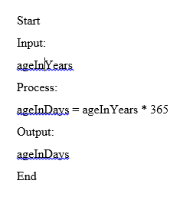
ANSWER Q2

Slide 18
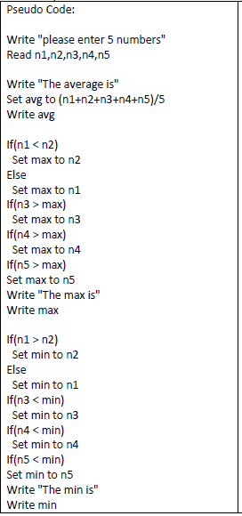
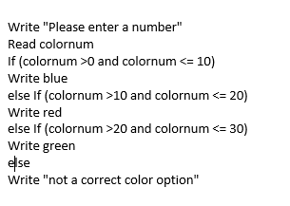
ANSWER Q3 & Q4

Slide 19
THANK YOU
Any questions?

